Slide 1
Am I a Good Story Teller Let’s Try
A Data-Driven Approach To Cryptocurren
cy Speculation
How do Bitcoin markets behave? What are the causes of the sudden spikes and dips in cryptocurrency values? Are the markets for different altcoins, such as Litecoin and Ripple, inseparably linked or largely independent? How can we predict what will happen next?
Articles on cryptocurrencies, such as Bitcoin and Ethereum, are rife with speculation these days, with hundreds of self-proclaimed experts advocating for the trends that they expect to emerge. What is lacking from many of these analyses is a strong data analysis foundation to backup the claims.
The goal of this article is to provide an easy introduction to cryptocurrency analysis using Python. We will walk through a simple Python script to retrieve, analyze, and visualize data on different cryptocurrencies. In the process, we will uncover an interesting trend in how these volatile markets behave, and how they are evolving.

Slide 2
Project Requirements
A Relational DB for storing the time sensitive data
A Airflow Scheduler for running the continuous data task in a DAG
A Time Series database to store the fetched data and
A Docker running environment
A Docker orchestration engine for monitoring and scaling
Logging and Monitoring tools such as AWS cloud watch , Airflow scheduler etc and ofcourse
A good Python Developer

Slide 3
Flowchart
Central API Storing Real time data
Airflow scheduler running script every 10 mins
Storing on Real time DB
Populating graphs out of it
Sql Server fetching that JSON Data

Slide 4
What is Apache Airflow
CRON IS SO REGULAR , Here is Airflow
Airflow is a platform to programmatically author, schedule and monitor workflows.
Use airflow to author workflows as directed acyclic graphs (DAGs) of tasks. The airflow scheduler executes your tasks on an array of workers while following the specified dependencies. Rich command line utilities make performing complex surgeries on DAGs a snap. The rich user interface makes it easy to visualize pipelines running in production, monitor progress, and troubleshoot issues when needed.
When workflows are defined as code, they become more maintainable, versionable, testable, and collaborative.

Slide 5
How it Works
Create the Airflow server on Docker
Start the webserver
Create DAG which is collection of acyclic graphs running in a continuous but a non reversible fashion

Slide 6
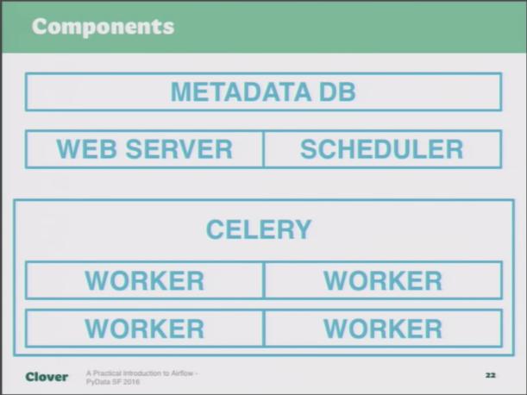
Architecture

Slide 7
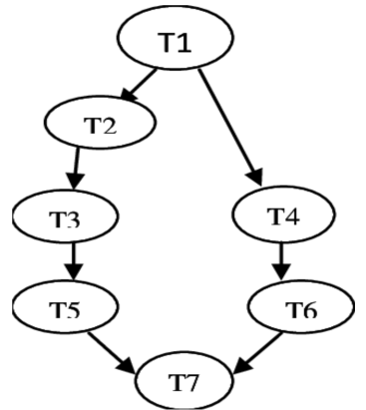
What is Airflow DAG
Collection of tasks running in a continuous fashion which makes the Data pipeline

Slide 8
Airflow DAG Creation
We can use default arguments for stuff like Monitoring , give email ID for data pipeline monitoring etc
Create tasks within DAG and choose the task dependency
Create Tasks using operators for eg we want to run Python tasks , we will use Python operator for that

Slide 9
Do we have the code to schedule/cron ??
import requests
# Where USD is the base currency you want to use
json_url = 'https://www.alphavantage.co/query?function=CURRENCY_EXCHANGE_RATE&from_currency=USD&to_currency=BTC&apikey=TLPB5KRYPO2BX23A'
Making our request
response = requests.get(json_url)
data = response.json()
# Your JSON object
print(data)

Slide 10
Above will give the JSON Output from
{
'Realtime Currency Exchange Rate': {
'1. From_Currency Code': 'USD',
'2. From_Currency Name': 'United States Dollar',
'3. To_Currency Code': 'BTC',
'4. To_Currency Name': 'Bitcoin',
'5. Exchange Rate': '0.00008882',
'6. Last Refreshed': '2019-08-13 11:38:29',
'7. Time Zone': 'UTC',
'8. Bid Price': '-',
'9. Ask Price': '-'
}
}

Slide 11
Do we have an DB Server ?
Create a DB Mysql or Postgres server
Create bitcoin database
Create a bitcoin table
Run or Schedule code from Airflow to input the JSON data into Table

Slide 12
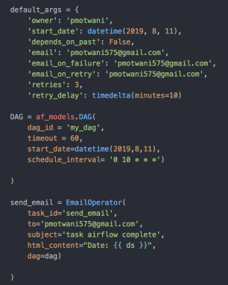
AIRFLOW DAG
Will create a Cron and run script every 10 mins

Slide 13
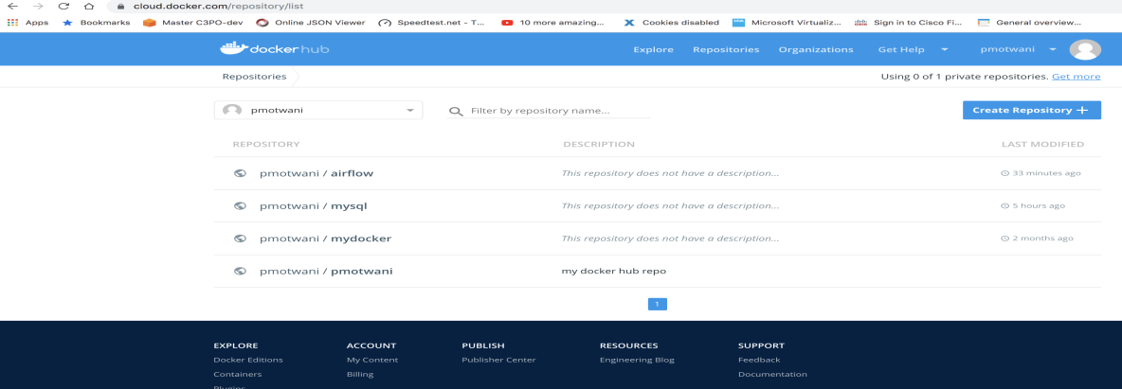
Docker HUB Images for Amazon ECS
We will push both the images to docker hub which we will be running inside ECS Fargate for Tasks failures and scallabitiy .

Slide 14
Amazon ECS for Scaling and Task Monitoring
We will create task definition
Use the pushed Images from docker hub
Create Services for Task definations inside which we will use Amazon ELB
We will run multiple tasks inside taks definition and use Autoscaling feature
Use autoscaling under SERVICE creation for scalabitly
Properly choose TASK CPU and Memory
Don’t use soft limit while creating container definition because it will create conflicts

Slide 15
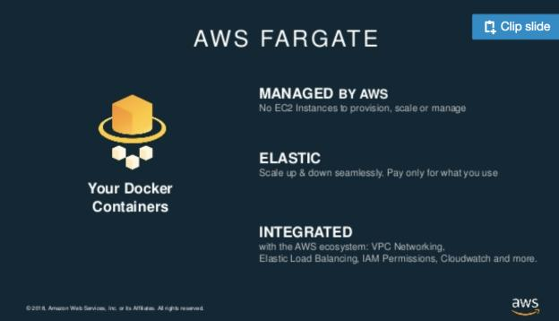
Fargate features

Slide 16
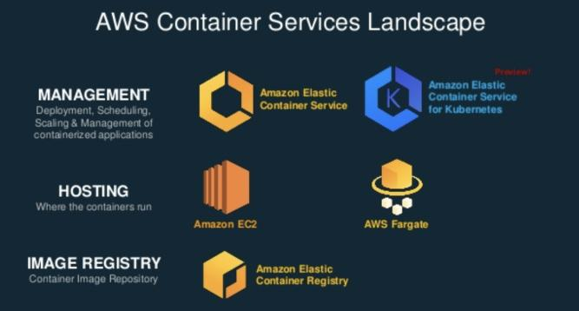
Container Lifecycle

Slide 17
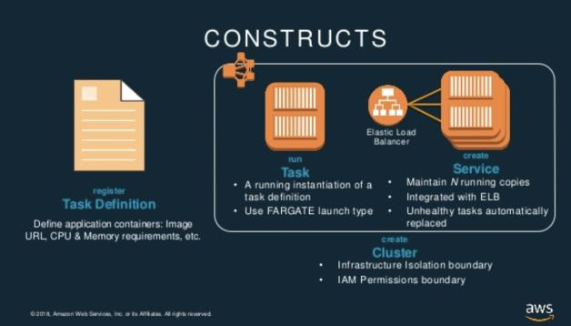
Task definition and service

Slide 18
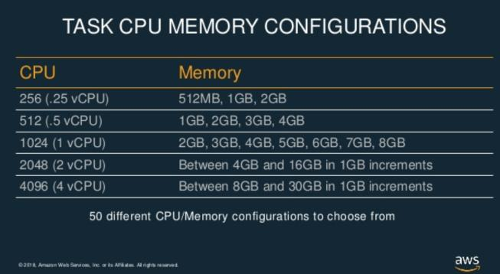
CPU and Memory constraints

Slide 19
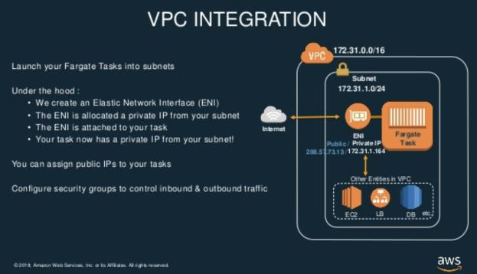
VPC Integration for Security

Slide 20
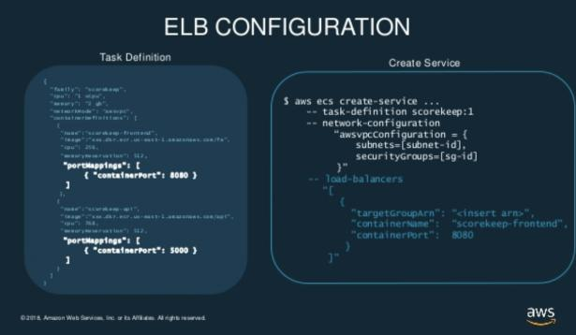
ELB Configuration

Slide 21
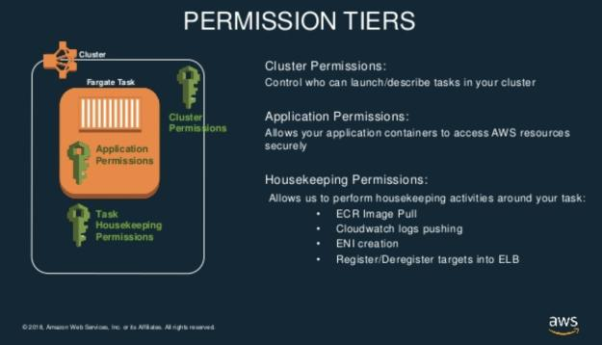
Permissions tiers

Slide 22
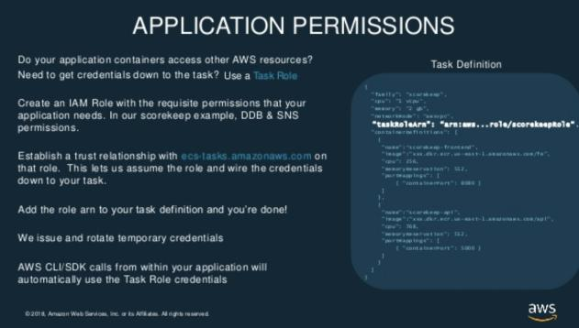
Application permissions

Slide 23
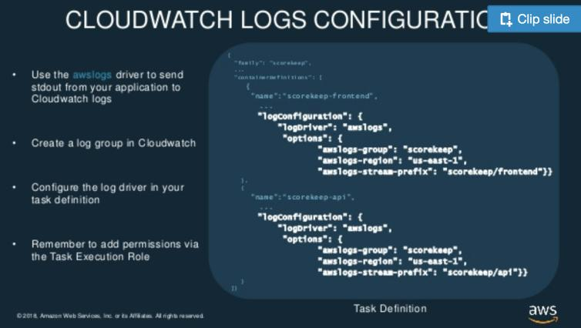
Tasks and Logs Monitoring with cloud watch

Slide 24
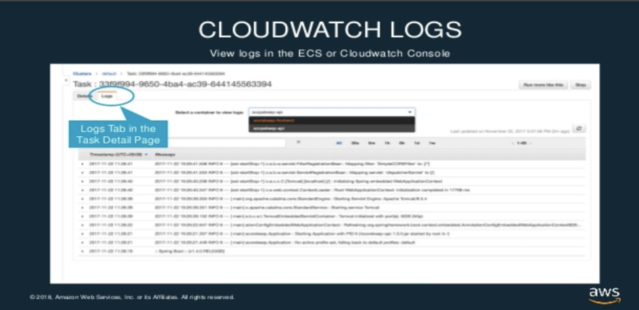
Monitoring Cloud watch logs

